Slide 1
Improve Efficiency of Reconciliation
Problem Statement :
Messages communicated between 2 or more IT applications are getting corrupted or lost, causing variance in the data maintained by these applications.
Context :
Currently, IT applications communicate to each other using XML messages which are being communicated via Message Queues (MQs). The application that receives the message sends the ACK or NACK back to the application which sends the message. Millions of messages per day will be communicated in this manner. Due to lost messages or errors, the data between these applications is not consistent, causing variance and resulting in manual reconciliation efforts.
What to Deliver?
Can Blockchain or some other solution/technology solve this problem ? if so, what would the solution look like ? what software/Hardware configuration is needed and can this solution be deployed to communicate between 2 different companies having firewalls ?

Slide 2
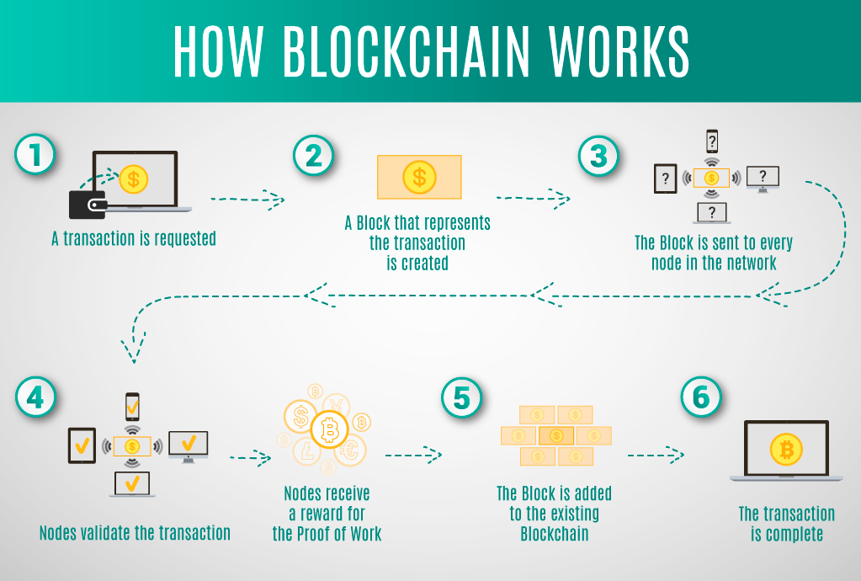
Blockchain

Slide 3
Possible Errors
Errors:
Complete Loss of Data
Request not received
Corrupted Data
Delay of Messages
Not Sequential

Slide 4
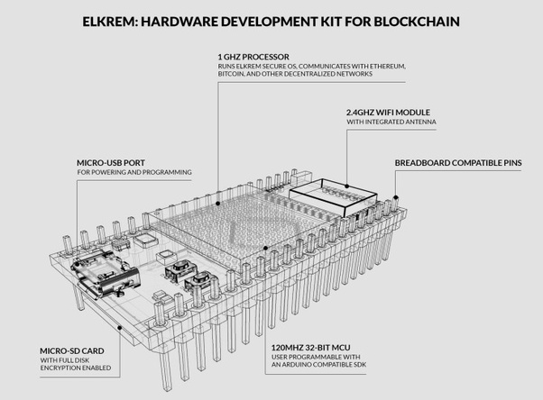
Software and Hardware Requirements
1 GHZ Processor
4 GHZ Wifi Module
BreadBoard
USB-port
SD card port
32 Bit MCU
Considering our requirement of millions of transactions we can use, ASIC: Application Specific Integrated Circuit chips
Smart Contracts

Slide 5
Overcoming Drawbacks of Blockchain
For any Blockchain solution to succeed :
It must be scalable
It must have fraud, theft and loss protections
It must have a versatile privacy solution
It must have price stability
Best solution: Devvio (Devcash) by using a new protocol achieving 3 million TPS

Slide 6
Future Scope

